Slide 1
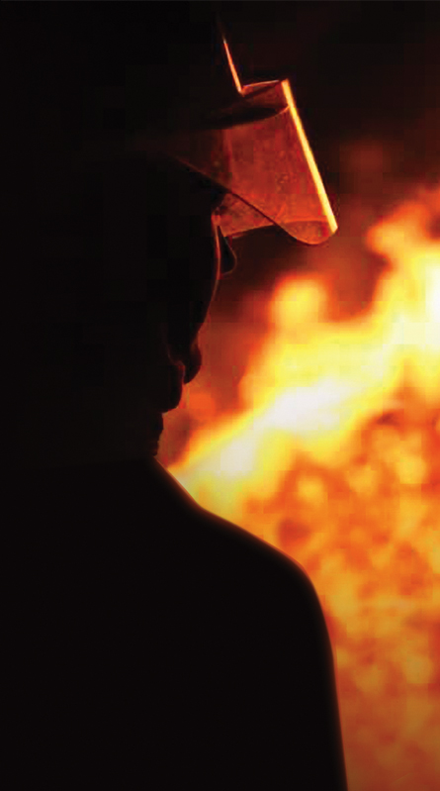
KS2
Fire Safety

Slide 2
This presentation will help to identify:-
how the local fire service works
fire risks
reducing hazards around the home and in camp
a bed time routine
an escape plan
fire extinguishers and their use

Slide 3
Role of a firefighter

Slide 4
Predict the safety messages in the following animations:

Slide 5
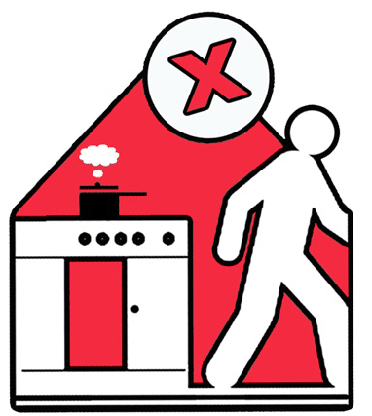
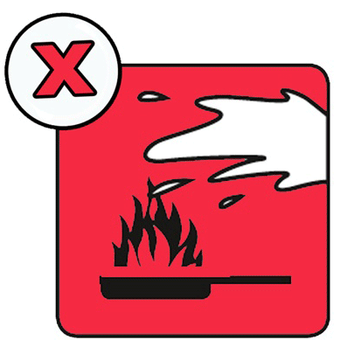
Cooking
Do not leave pans unattended
Is occupier burning food due to forgetfulness?
Is chip pan/hot oil being used?
Never try to put out oil fire with water

Slide 6
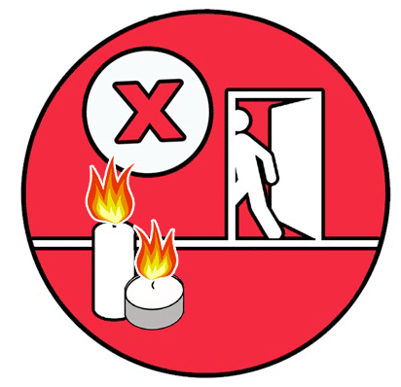
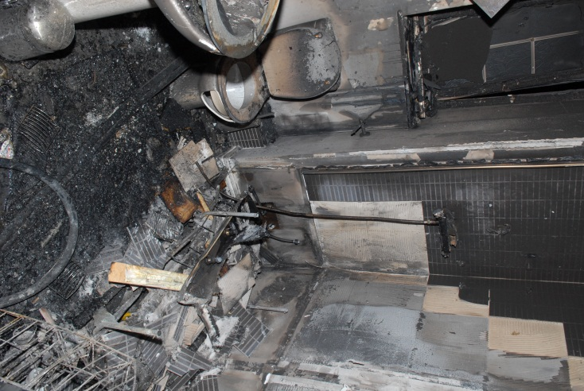
Candles
Never leave candles unattended
Keep away from flammable fabrics (e.g. curtains) and surfaces (e.g. baths)
Bath fire caused by candles

Slide 7
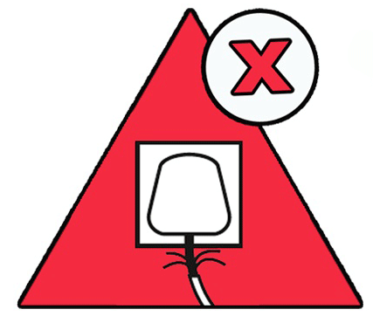
Electrical
One plug socket supplies 13 amps of electricity
If an appliance gets hot or cold it usually needs
all the electricity from that one socket to work
safely (kettle, toaster, washer, dryer, hair dryer,
hair straighteners, fridge, freezer)
Appliances use different amounts of power. A lamp may use 3 amps and a TV 5 amps. If an adaptor is needed, make sure it is using less than or equal to 13 amps
If cables are frayed or in bad condition they may catch fire

Slide 8
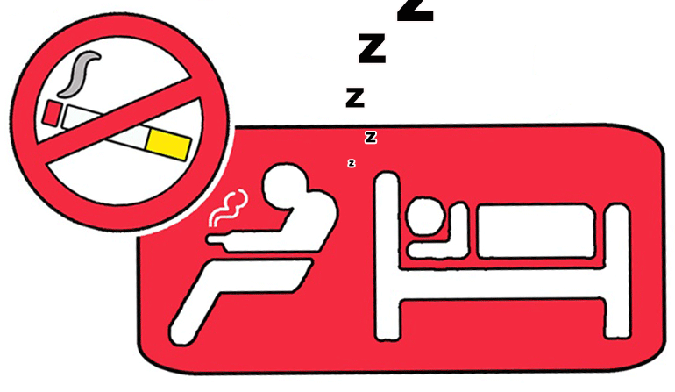
Smoking
Always use an ash tray
Are cigarettes left burning
in ash trays around the home?
Never smoke in places where you are likely to fall asleep

Slide 9
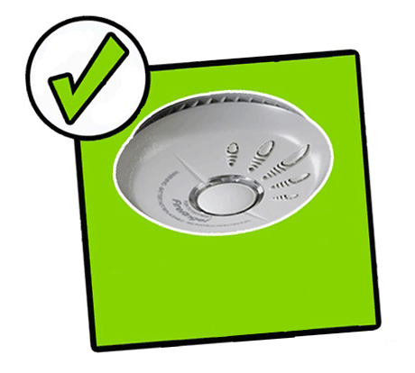
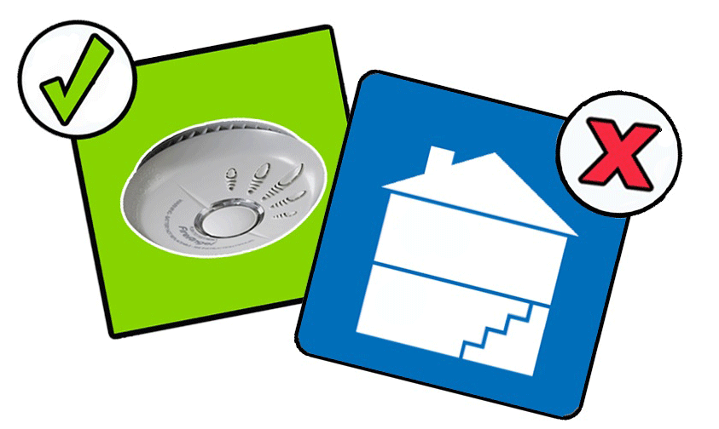
Smoke alarms
Smoke alarms warn you that there is a fire. Check they are working once a week by pressing the tester button. Use a broom handle rather than climbing a step ladder
Smoke alarms should
be fitted on each floor level

Slide 10
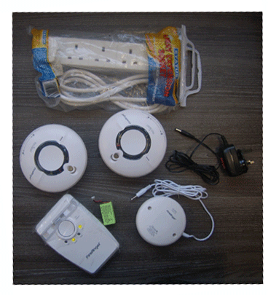
Smoke alarms
We have specialist alarms
which will alert those
with hearing impairment
in the event of a fire.

Slide 11
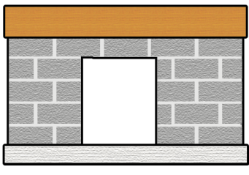
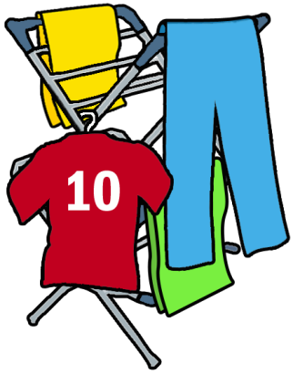
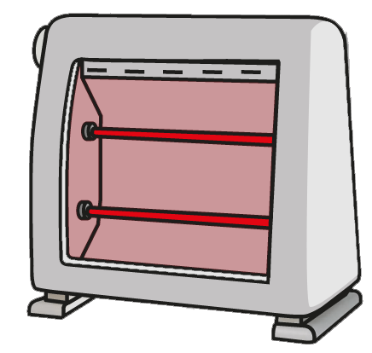
Home safety

Slide 12
Bed time routine
Close doors at night. They will hold back a fire and prevent poisonous smoke from filling the house
Make sure that exits are kept clear.
Too much clutter can affect escape and intensify the spread of fire

Slide 13
Aiding escape
Keep keys in a safe place (on a hook/ in a drawer) near to the main escape door (not in another room)
In the event of a fire
Get out, stay out and call 999 for the fire service

